Slide 1

Interactive Sales Analysis Dashboard
Unlocking insights and driving sales success with Power BI

Slide 2

Project Objectives
1
1. Overview
2
2. Trend Analysis
Key sales metrics at a glance
Identify patterns and opportunities
3
3. Customer Insights
High-value customer segmentation

Slide 3
Data Used in Analysis
Orders
Customers
Products
Operations
Order Number
Customer Name
Product Details
Warehouse Code
Order Date
Channel
Product Quantity
Delivery Region
Shipping Date
Currency Code
Unit Price
Total Unit Cost

Slide 4
Dashboard Overview
Overview Page: Key sales metrics
1
2
Sales Trends: Time-based analysis
Customer Insights: High-value customer identification
3
4
Channel Analysis: Sales channel performance
Product Performance: Top-selling products and profitability
5

Slide 5

Key Insights
Top Metrics
Sales Trends
Total Sales, Average Unit Price, Total Unit Cost
Seasonal peaks, holiday sales
Customer Insights
Top 5 customers contribute X% of revenue

Slide 6

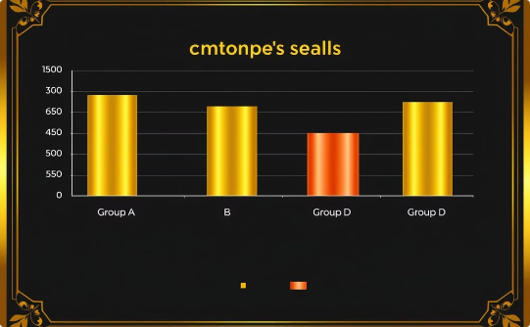
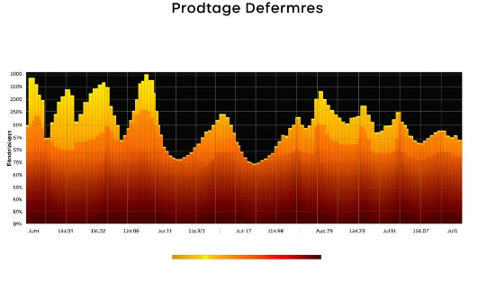
Dashboard Visuals
Line Chart
Bar Chart
Heatmap
Sales trends over time
Customer sales comparison
Product performance visualization

Slide 7



Conclusion and Recommendations
1
Efficiency Gains
2
Decision Support
3
Scalability

